Slide 1
Welcome to CanSkate!
An introductory presentation by the Ajax Skating Club

Slide 2
Our Topics for Today
01
04
About Us
Let’s Talk Helmets
02
05
Program Overview
Let’s Talk Clothing
03
06
Let’s Talk Skates
What to Expect

Slide 3

The Ajax Skating Club
01: About Us
We are a local not-for-profit Skate Canada sanctioned organization that has been committed to teaching people how to skate for over 50 years.
Our professional coaches are dedicated to creating a safe, inclusive learning environment that enables our skaters to have fun and accomplish their goals.

Slide 4
02: Programs Offered at the ASC
01
02
03
Pre-CanSkate
CanSkate
CanSkate Elite
A program for beginner and experienced children (ages 4+). It is divided into 6 stages.
A program for skaters that have completed CanSkate Stage 3.
A beginner program for preschool aged children.

Slide 5
02: Programs Offered at the ASC
04
05
06
07
Pre-Star
Starskate
Hockey/Ringette Skating Skills
Adult/Teen
A program for skaters that have completed CanSkate Stage 4 and are interested in figure skating.
A figure skating program for those who have completed CanSkate.
A program for adults and teens looking to learn to skate.
A program that focuses on specific skating skills for hockey and ringette.
Check out our site for more details on these programs!

Slide 6
03
Let’s Talk Skates

Slide 7

Skate Tips
Shopping
Maintenance
Skating equipment can be found at most sporting goods stores
Before buying, check for fit, firm ankle support, and good quality
Leather boots are preferred, avoid molded plastic skates
Skates should use laces, not click-in straps
Avoid buying larger sizes: poor-fitted equipment will make skating difficult
Skates should be sharpened at the beginning of the season and every 2-3 months after that
Wipe snow off blades after each session to prevent rust
If there is rust on the blade bottom, the skate should be sharpened
Do not store skates with skate guards on

Slide 8
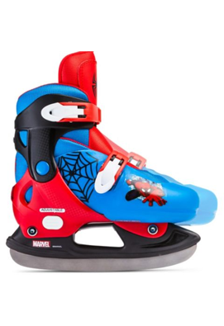
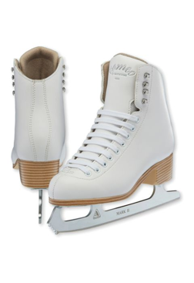
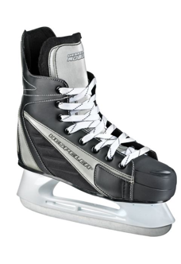
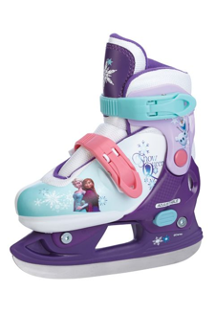
Examples
Good
Bad

Slide 9

Fitting and Tying Skates
Skates need to fit well and provide support to the ankle
They should be snug around the ankle with some movement for toes
There should only be one finger of space behind the heel
Skaters should feel comfortable and be able to bend their knees in their skates
Play from 1:02-6:40
https://youtu.be/zazpYjvXtag

Slide 10
04
Let’s Talk Helmets

Slide 11
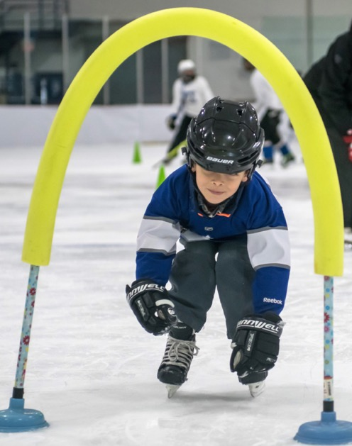
Proper Helmet Wear
All skaters are required to wear a CSA approved hockey helmet
Be sure that your helmet has not expired – yes helmets have an expiry date
Helmets should fit snug with minimal forehead showing
Both the strap and helmet should be adjustable
The strap should be done up properly with a maximum of one finger space between the strap and chin
Hair should be pulled back and out of the way, but not in a ponytail as that interferes with the proper fit
Image from Skate Canada official website

Slide 12
05
Let’s Talk Clothing

Slide 13
How to Dress for Skating
Clothes should be warm but not restrictive
Layering and waterproof pants are recommended
Nothing should be hanging or too long, such as scarves and long pants
We suggest you wear a warm sweater or jacket and trackpants, not jeans

Slide 14
Specifics
Mittens
Hats and Socks
Other Items
Wear warm mittens or gloves and avoid fuzzy fabrics as they stick to the ice.
Do not wear a hat under your helmet.
Wear tights/leotards or long socks that come above the skate.
Knee pads and shin pads are not recommended.

Slide 15
Equipment Summary

Slide 16
Summary: Equipment Do’s and Don’ts
Do’s
Don’ts
DO buy leather skates with laces and spend time learning how to tie them properly
DO use a CSA approved helmet and follow the safety guidelines
DO wear warm and comfortable clothing
DON’T buy plastic skates with clasps
DON’T forget to sharpen your skates
DON’T use a loose or ill-fitted helmet
DON’T wear restrictive or bulky clothing

Slide 17
06: What to Expect

Slide 18
What to Expect on the First Day
Location: Pad #2
Arrive early to allow enough time to get ready and find your way around
Change Rooms
  should be used to get ready instead of the hallway or main lobby
  should have labels, but double-check through the monitor in the lobby to ensure you enter the right room
Name Tags
  show your child’s name and a coloured dot indicating their group
  are found on a table in the hallway
  should be clipped to your child’s jacket.

Slide 19
What to Expect on the First Day (pt. 2)
All skaters will enter the ice through the Pad #2 doors in the hallway
Please do not carry your skater to the ice surface. We want them to walk independently. This is especially important for our Pre-Can skaters
Please do not send your child on to the ice with a water bottle/drink
Once all skaters are on the ice, the doors will be closed for safety purposes
Please do not leave the arena
  in the event that you are needed, we have no way to find or get in touch with you if you leave the building
  during the session we ask that you remain present and attentive
  coaching staff are unable to take your child to the washroom, so you may be signaled to take them yourself

Slide 20
Good Habits to Maintain
General
Parents/Caregivers
Skaters
Arrive 20-30 minutes early so that you have time to get dressed, put skates on, and get your name tag
Stay involved in the learning process. Be present and attentive. your skaters look to you for support!
Have fun and be kind. You’re here to learn to skate and join a wonderful community, enjoy it!

Slide 21
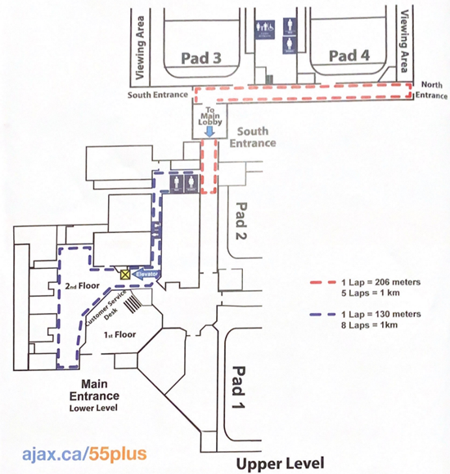

Ajax Community Centre Guide
Our rink!
Hallway with Dressing Rooms and Arena Entrances
Enter here!

Slide 22
THANKS!
Detailed information on equipment can be found on our website ajaxskatingclub.ca under the Learn to Skate Programs section.
Do you have any questions?

Slide 23
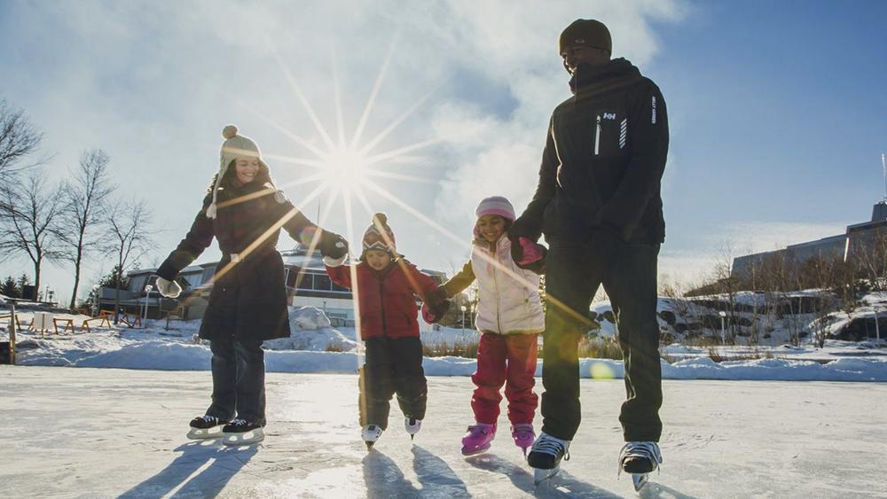
We hope you enjoy partaking in this great Canadian tradition and family activity!

